Slide 1


NGO & NPO
Career Development Centre
SRMIST – Kattankulathur

Slide 2
NGO
Non Government Organisation , an association formed by citizens that functions completely autonomous from government, to perform broad spectrum of services and humanitarian function.
NGO was first coined in 1945 when the United nation was created and there were 1083 NGO's, based on society registration act NGO was approved in 1860.
India has almost 31Lakh NGO at present.
Career Development Centre
SRMIST – Kattankulathur

Slide 3
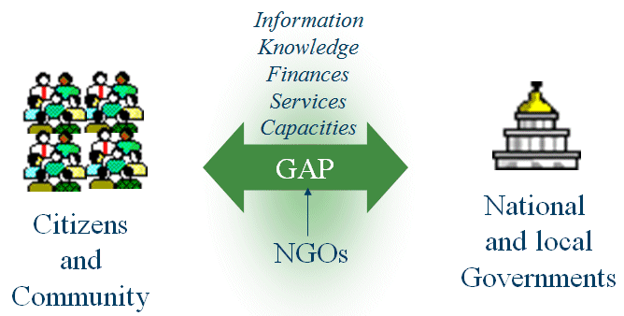
NGO Duties
community health promotion & education
managing emerging health crises
environmental issues
economic empowerment
development projects
women & children’s’ rights
Career Development Centre
SRMIST – Kattankulathur

Slide 4
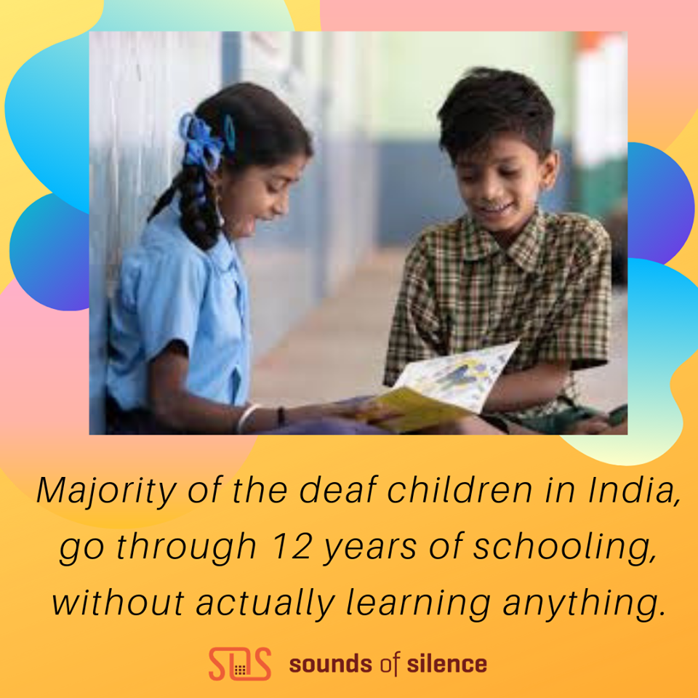

NGO - Example
Career Development Centre
SRMIST – Kattankulathur

Slide 5
NPO
Non profit organisation is a legal entity formed by a group of persons to promote cultural, religious professional or social objective.
It is registered under section 8 of companies act.
Such organization and enjoys several privileges like tax exemption not required to use limited or private limited at the end of its name.
Career Development Centre
SRMIST – Kattankulathur

Slide 6

NPO Duties
Religious
Charitable
Scientific
Public safety
Literary
Educational
Fostering national or international amateur sporting,
Preventing cruelty to children or animals but all on a much smaller scale than NGO
Career Development Centre
SRMIST – Kattankulathur

Slide 7

NPO - Example
Career Development Centre
SRMIST – Kattankulathur

Slide 8
Difference between NGO & NPO
NGO | NPO
Registered as a Trust under Public Trust Act, or as a Society as a Societies Registration Act, 1860 or as a non-profit company under the Companies Act, 1956. Large To bring awareness of human rights, women empowerment etc. | Under section 8 of the Companies Act, 1956. Limited To promote art, science, research, commerce or any other useful purpose.
Career Development Centre
SRMIST – Kattankulathur

Slide 9
Organisational Structure
Staffing
Funding
Overhead cost
Monitoring and Control
Career Development Centre
SRMIST – Kattankulathur

Slide 10
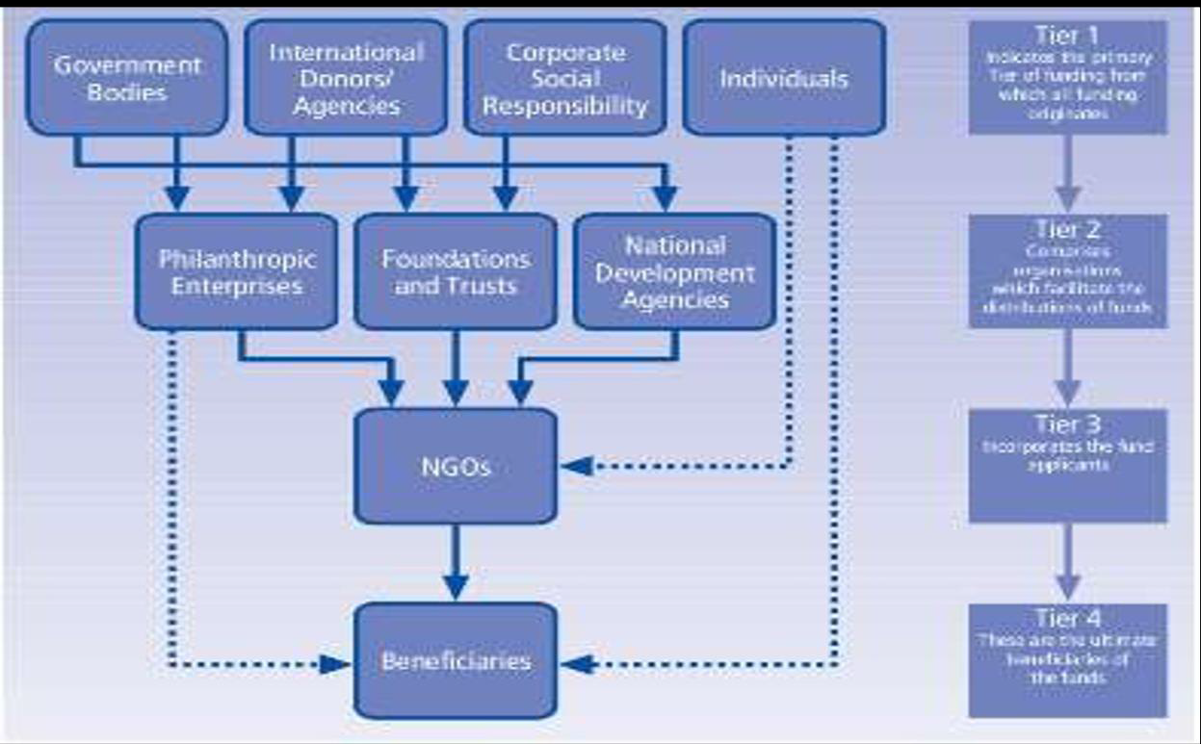
Working of NGO
Career Development Centre
SRMIST – Kattankulathur

Slide 11
Types of NGO
Level of orientation
Charitable Orientation
Level of operation
Community-based Organizations
Citywide Organizations
Empowering Orientation
Service orientation
Participatory Orientation
National NGOs
International NGOs
Career Development Centre
SRMIST – Kattankulathur

Slide 12
Level of orientation
Charitable Orientation
Service orientation
Participatory Orientation
Empowering Orientation

Slide 13



Charitable Orientation
NGOs with activities directed toward meeting
the needs of the poor -distribution of food,
clothing or medicine; provision of housing,
transport, schools etc.
also undertake relief activities during
a natural or man-made disaster.
Career Development Centre
SRMIST – Kattankulathur

Slide 14


Service orientation
activities such as the provision of health,
family planning or education services in
which the programme is designed by the NGO
and people are expected to participate in it
implementation and in receiving the service.
Career Development Centre
SRMIST – Kattankulathur

Slide 15


Participatory Orientation
Participatory Orientation is characterized
by self-help projects where local people are
involved particularly in the implementation
of a project by contributing cash, tools,
land, materials, labour etc.
Career Development Centre
SRMIST – Kattankulathur

Slide 16


Empowering Orientation
To help poor people develop a clearer
understanding of the social, political
and economic factors affecting their
lives, and to strengthen their awareness
of their own potential power to control their lives.
Career Development Centre
SRMIST – Kattankulathur

Slide 17
Level of orientation
Community-based Organizations
Citywide Organizations
National NGOs
International NGOs

Slide 18
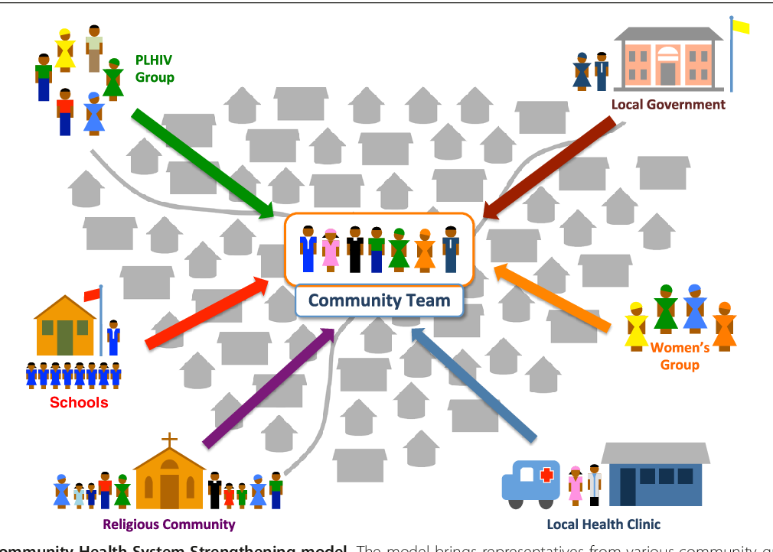
Community-based Organizations
include sports clubs, women‘s
organizations, neighborhood
Organizations, religious
or educational organizations.
Career Development Centre
SRMIST – Kattankulathur

Slide 19


Citywide Organizations
include organizations such as the Rotary
or lion's Club, chambers of commerce and
industry, coalitions of business, ethnic or
educational groups and associations
of community organizations
Career Development Centre
SRMIST – Kattankulathur

Slide 20


National NGOs
National NGOs include organizations such as the Red cross, YMCAs/YWCAs, professionalorganizations etc. Some of these have state and city branches and assist local NGOs.
Career Development Centre
SRMIST – Kattankulathur

Slide 21

International NGOs
International NGOs range from
secular agencies such as Redda BArna and
Save the Children organizations,
OXFAM, CARE, Ford and Rockefeller
Foundations to religiously motivated groups
Career Development Centre
SRMIST – Kattankulathur

Slide 22
Approaches under NGO
Grassroots development : It targets disadvantaged groups through small, locally based projects
Humanitarian/Emergency Relief: It focuses on relief in times of disaster
Advocacy: It aims to draw public attention to an issue and influence government policy either on behalf of, or alongside, a particular community interest group.
Volunteer: Programs run by NGOs facilitate sending volunteers overseas to offer technical assistance
Career Development Centre
SRMIST – Kattankulathur

Slide 23
Thank You
Career Development Centre
SRMIST – Kattankulathur

